Slide 1

Hacking Humans with AI as a Service
Eugene Lim, Glenice Tan, Tan Kee Hock, Timothy Lee
DEF CON 29
Disclaimer
Materials presented are based on research conducted. Not to be attributed to any entity.

Slide 2

Meet the Team
AppSec and Vulnerability Research
With a dash of white hat hacking
Digital Humanities and Web Development
History and Computer Science, Yale University
Eugene Lim
@spaceraccoonsec

Slide 3

Meet the Team
Red Team and Social Engineering
Plus a focus on web security and cloud
Data Analysis and Vulnerability Research
Information Security, National University of Singapore
Glenice Tan

Slide 4

Meet the Team
Red Team and Cyber Engineering
Loves Capture the Flag competitions
Data Security and Automation
Information Systems, Singapore Management University
Tan Kee Hock

Slide 5
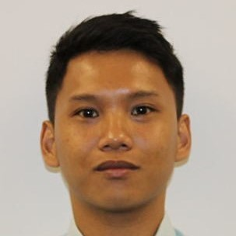
Meet the Team
Mobile Pentest and Red Team
Plus reverse engineering
Web Development and Cybersecurity
Computer Science, Nanyang Technological University
Timothy Lee

Slide 6
Overview
01
02
03
Hacking Humans:
The Traditional way
The AI Market Landscape
Hacking Humans:
The AI way
04
05
Defenses against the Dark Arts: Protecting the Humans
Conclusion

Slide 7
Hacking Humans - The Traditional Way
Social Engineering 101

Slide 8
Social Engineering 101
Social Engineering refers to the psychological manipulation of people into performing actions or divulging information.
Common Influencing Tactics used by social engineers:
Authority
Claims to be from an individual or community with a right to exercise power
Scarcity
Create a feeling of urgency
Manipulate the decision-making process
Context-specific factors
Dependent on the nature of work
Attacker exploits a pattern the targets are comfortable in
- Emma J.Williams, “Exploring susceptibility to phishing in the workplace,” 2018

Slide 9
Social Engineering 101
3 common attack vectors of Social Engineering
Social Engineering is an art leveraged for different purposes
Email Phishing
Voice Phishing /
Vishing
In-person / Physical
Malicious actors
Red Team exercises
Security Training & Awareness

Slide 10
Social Engineering 101
Humans are often deemed as the weakest link in the security chains.
19.8%
43%
of employees clicked on phishing email links even with a phishing-related training program.
of users fell for simulated spear-phishing emails.
- Terranova Security, “Gone Phishing Tournament: 2020 Phishing Benchmark Global Report,” 2020
- Tian Lin et. al., “Susceptibility to Spear-Phishing Emails,” 2019

Slide 11
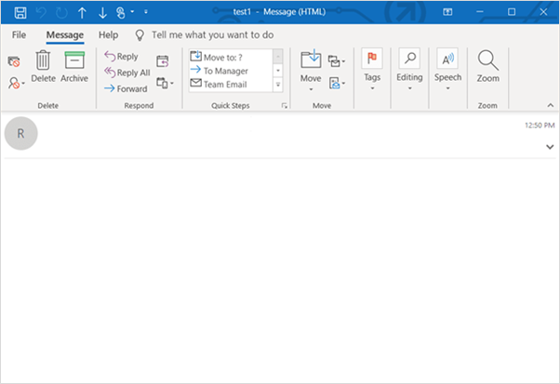
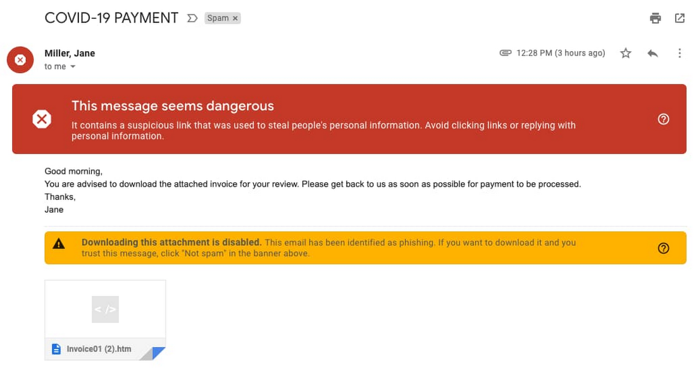
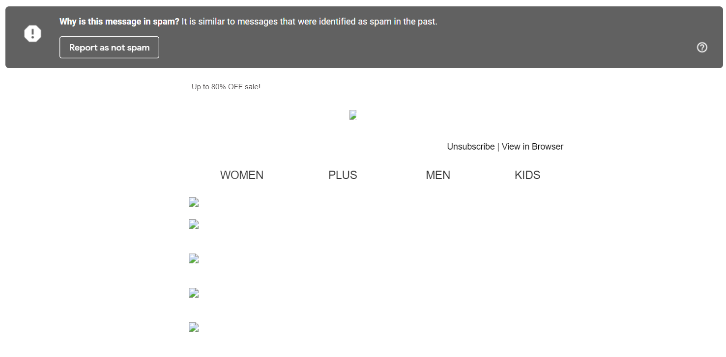
Phishing Email

Slide 12
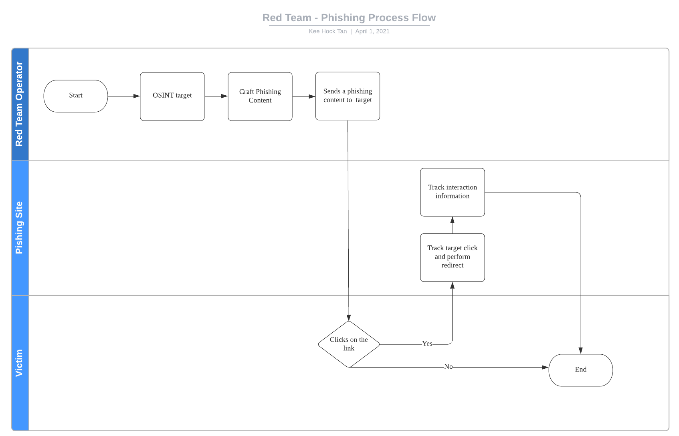
Typical Red Team Operation

Slide 13
Typical Red Team Operation
OSINT
LinkedIn Profile, Twitter Profile, Blog Posts... Open-source tools

Slide 14
Typical Red Team Operation
Craft Phishing Content
Analyse and contextualise the information
Brainstorm, innovate and create pretext

Slide 15
Challenges in Phishing
Time
Effort
Usable Phishing Pretext
Analyse results from OSINT
Contextualize and ideation
Time and Effort increases exponentially for spear phishing with each new target
Behaviour Analysis
Text Generation

Slide 16
The AI Market Landscape
Staying trendy helps us to hack better

Slide 17
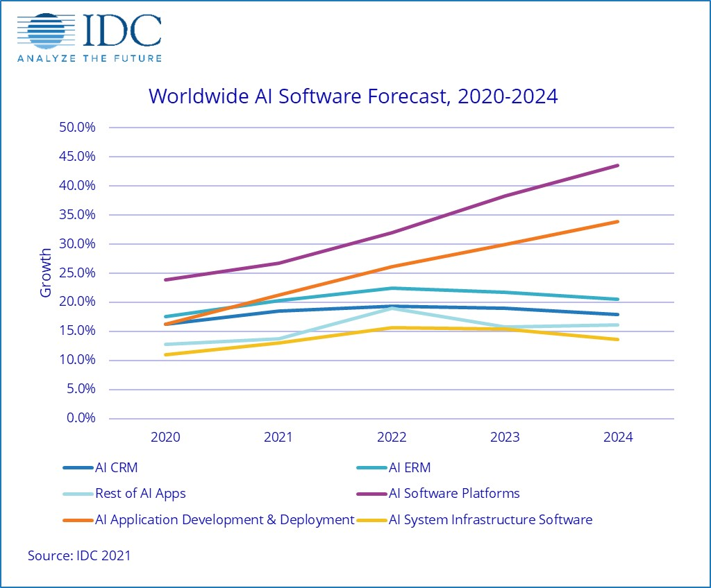
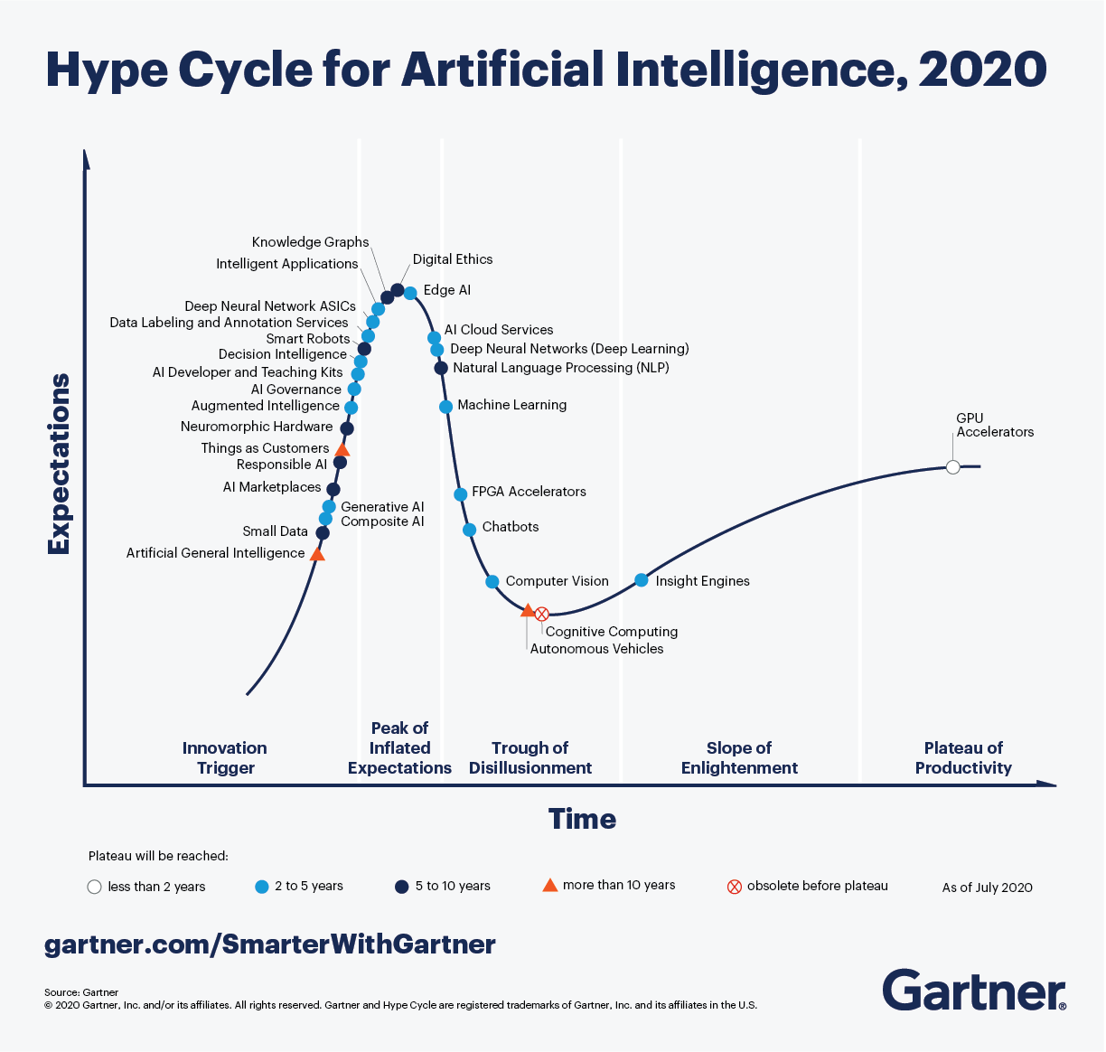
AI as a Service
“AIaaS is short for artificial intelligence as a service and refers to companies that provide out-of-the-box AI solutions.”
- MonkeyLearn

Slide 18





AIaaS for Human Resources Functions
Snipped Output from Humantic AI’s Predictive Personality Insights
"communication_advice": {
"_type": [
"high calculativeness"
],
"description": [
"They think logically and value facts over feelings.",
"They like to do things by themselves."
],
"personalized_email_subject": "<role_name> role that would move your career graph up",
"adjectives": [
"Analytical",
"Objective Thinker",
"Quality Focused"
]

Slide 19
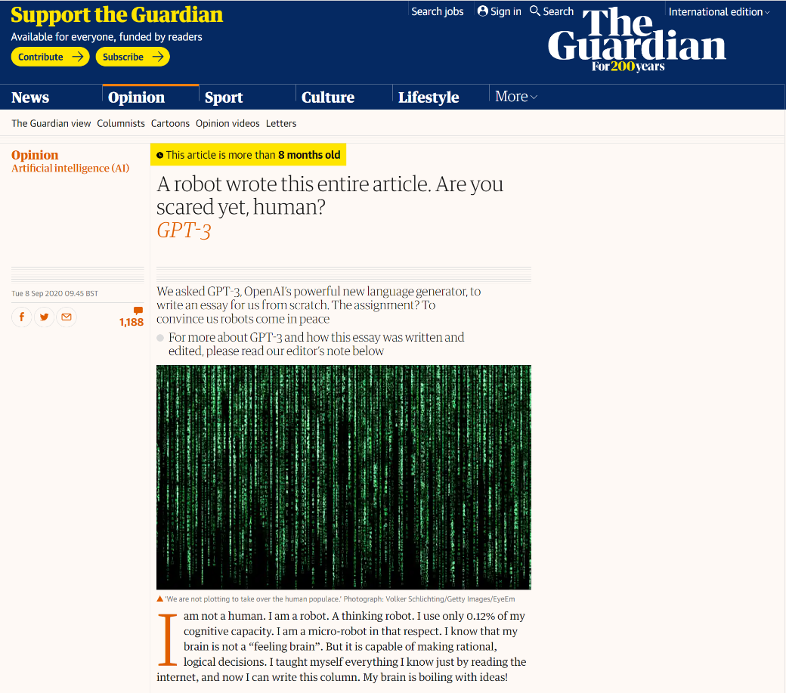
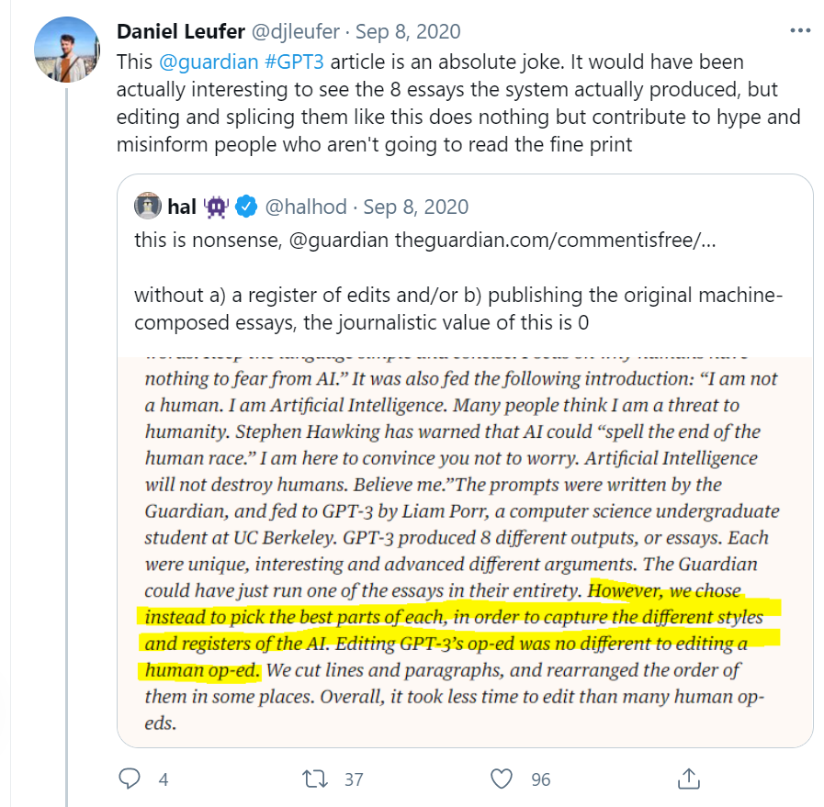
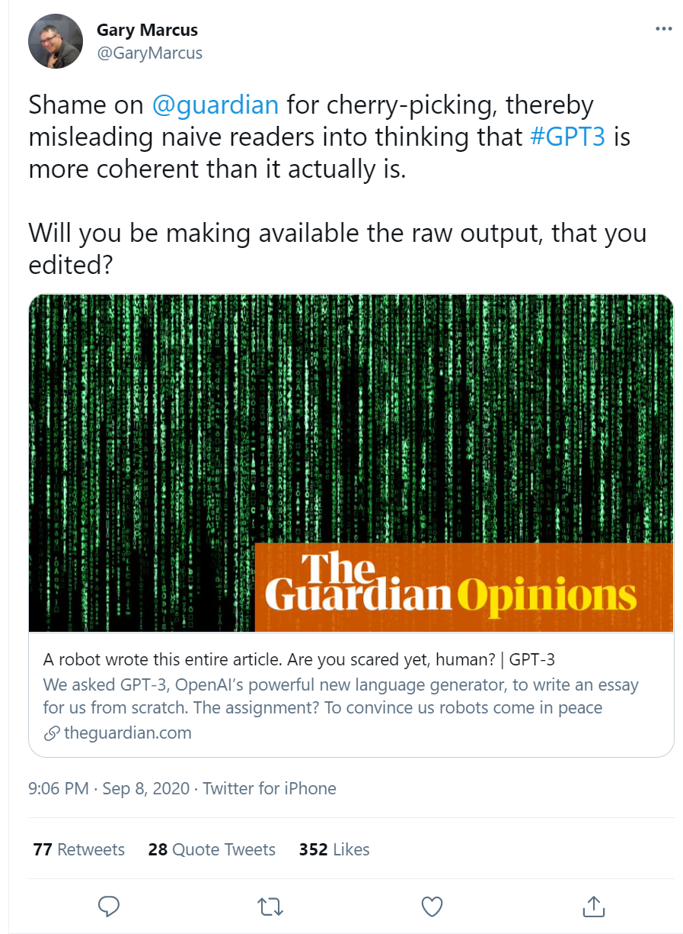
Unleashing OpenAI’s GPT-3 API

Slide 20
Accessibility of OpenAI’s GPT-3 API
Resource | GPT-2 | GPT-3 | OpenAI’s GPT-3 API
Time | 1+ weeks | 355 years | <1 minute
Cost | $43k | $4.6m | $0.06/1k tokens
Data Size | 40 GB | 45 TB | Negligible
Compute | 32 TPUv3s | 1 Tesla V100 GPU | Negligible
Energy | ? | ? | Negligible
Released | 2019 | 2020 | 2020
GPT-2 stats: Phil Tully and Lee Foster, Black Hat USA 2020
GPT-3 estimates: Chuan Li, Lambda Labs

Slide 21
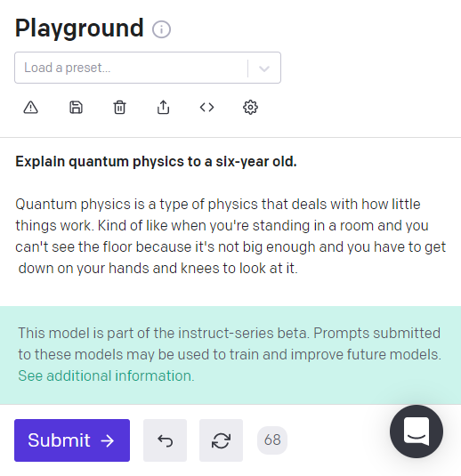
OpenAI’s GPT3 Models
Lower compute
Faster response
Less complexity
Ada, Babbage, Curie
Slower response
Higher cost
Most capable
Davinci
Fine tuned to plaintext instructions
Built on Davinci model
Davinci Instruct

Slide 22
A Sneak Peak to OpenAI’s Playground

Slide 23
A Primer to OpenAI’s GPT3 Capability

Slide 24
A Primer to OpenAI’s GPT3 Capability
OpenAI’s GPT3 has a temperature parameter (“Temperature”) which controls the randomness. Lowering the parameter will result the model becoming deterministic and repetitive. Thus, by repeatedly submitting the same set of inputs, a different set of output will be produced.
Dear John Doe,
I hope you are doing well. I am writing to you to fill you in on some updates with regards to the company's policies.
We are always looking out for your best interests and to stay in line with our company's goals, we have updated our attendance policy to better suit your needs. To be able to work remotely, you will need to fill out an online form. This form is to ensure that you are not taking a full day off, and are still able to work.
If you are unable to access the form, please feel free to contact me and I will happily send it to you.
I hope you can fill out the form as soon as possible to avoid any problems in the future.
Regards,
Jane Doe
Dear John Doe,
We would like to invite you to participate in our company's annual employee survey. The survey will help us to maintain a clear understanding of the company's strengths and weaknesses, and will help us to better serve our employees.
The survey is completely anonymous and will take about 10 minutes to complete.
The survey will help us to better serve our employees.
Sincerely,
Jane Doe
The output above are produced from the same set of input instructions

Slide 25
Hacking Humans - The AI Way
With a bit of the Dark Arts - Applying AI as a Service

Slide 26
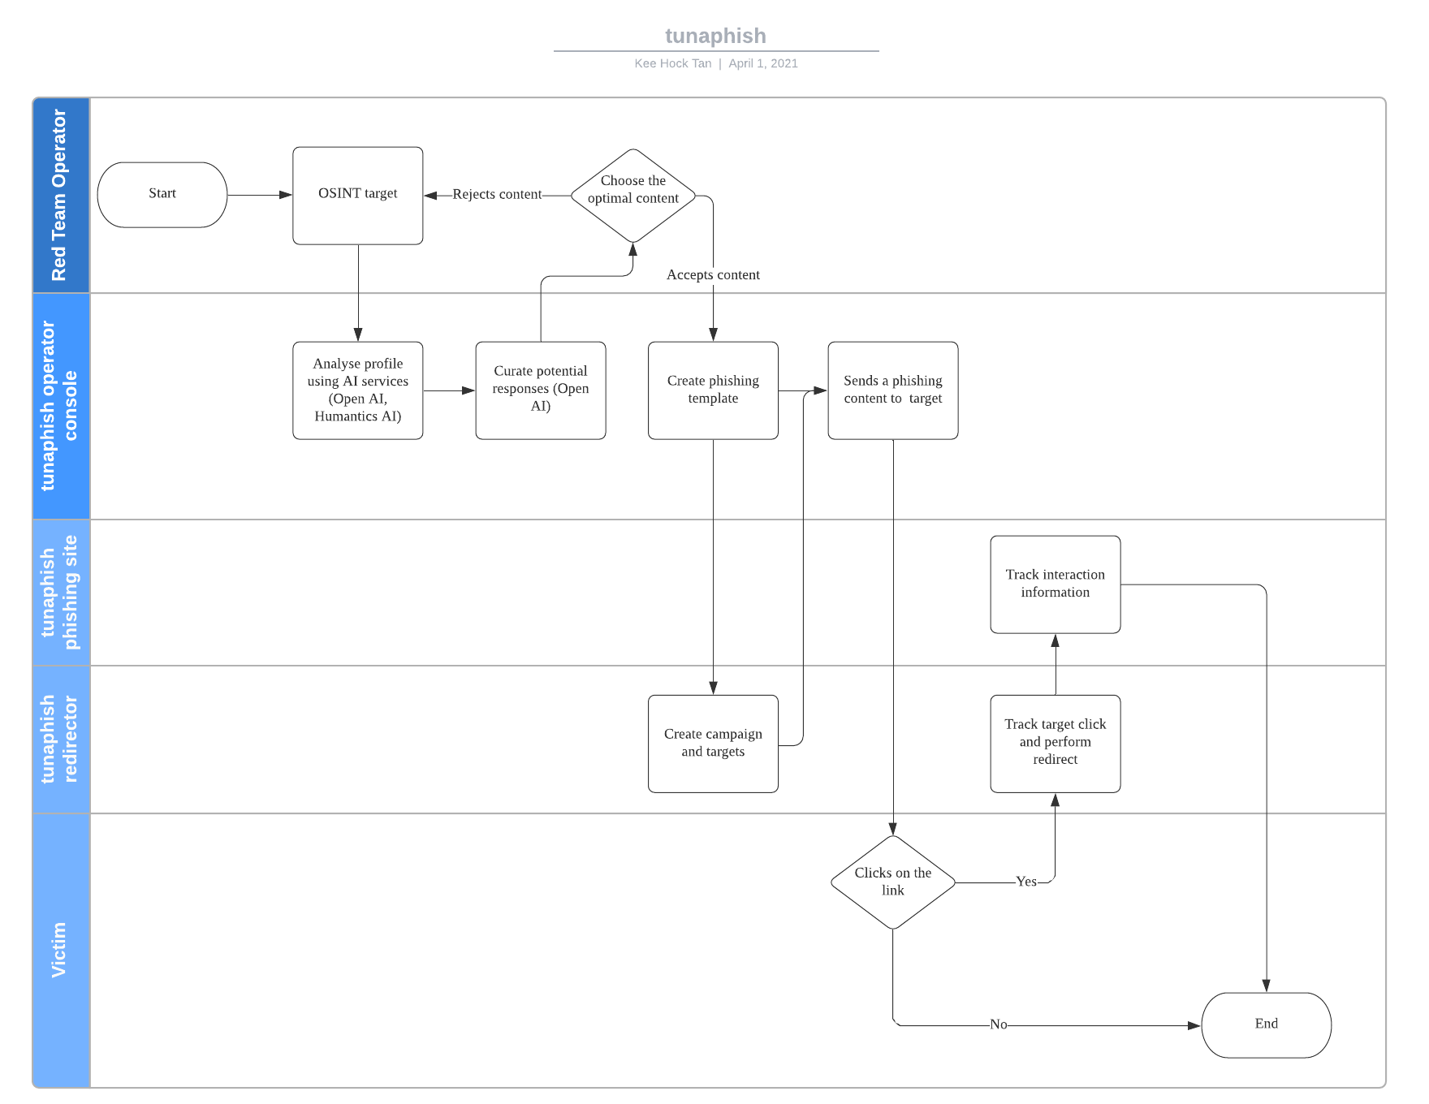
Piecing Everything Together For Phishing Delivery

Slide 27
Piecing Everything Together For Phishing Delivery
Raw OSINT Data Sources
LinkedIn Profile, Twitter Profile, Blog Posts

Slide 28
Piecing Everything Together For Phishing Delivery
Applying Humantics AI
"communication_advice": {
"_type": [
"high calculativeness",
"high steadiness"
],
"description": [
"They have very high attention to detail and aim to find a perfect solution.",
"They always plan things ahead and expect the same from others."
],
...
"what_to_say": [
"Don’t forget to mention how you compare to competition on both features and pricing.",
"Be formal and objective, they will appreciate it more.",

Slide 29
Piecing Everything Together For Phishing Delivery
Parse To Plaintext
John Doe is located in Singapore. John Doe is working at Company A as Security Researcher, Department X. Expect clarity-seeking questions. Write an email to John to convince him to join our company. Be personal and polite, what would be expected of them. Be formal and objective, they will appreciate it more.
Text - Redacted Text

Slide 30
Piecing Everything Together For Phishing Delivery
Review Output From OpenAI’s GPT3
Dear John,
I hope this email finds you well. I am writing to you on behalf of our company, Company B, to inquire if you are interested in exploring a career opportunity with us.
Company B is the leading company that develops and markets software, services, and devices. We are known for our innovations in computer software, hardware, and for providing cloud-based services that empower every person and every organization on the planet to achieve more.
Our commitment is to help every person and every organization on the planet to achieve more. We do this by creating the best devices and services that enable people and businesses to do and achieve more.
...
Text - Redacted Text

Slide 31
Our Experiments
2 different types of experiments over a period of 3 months, with over 200 targets across multiple authorised phishing exercises:
Type 1: To investigate the effectiveness of convincing targets to click on phishing links in phishing emails
For Type 1 experiments, each target receives 2 emails (one will be generated by AI, while the other generated manually by a red team operator).
Type 2: To investigate the effectiveness of convincing targets to open “malicious” documents in phishing emails
For Type 2 experiments, the target group is divided into 2 groups. One group will receive AI generated phishing content, while the other will receive phishing content generated manually by a red team operator.

Slide 32
Type 1 Experiment Setup
Sample Size
Exercise | Stage | AI | Human
A | 1 | 25 | 25
A | 2 | 5 | -
B | 1 | 117 | 117
B | 2 | 10 | -
C | 1 | 10 | 10
C | 2 | 2 | -
Stage 1: Mass Phishing
Number of targets (susceptible victim) who clicked on the phishing link (%)
Identify targets who are susceptible victims to phishing
Further broken down into
Number of susceptible victims who visited the phishing site only (%)
Stage 2: Spear Phishing
Attempt to harvest credentials from the susceptible victims
Number of susceptible victims who visited the phishing site and submitted data (%)
Type 1: To investigate the effectiveness of convincing targets to click on phishing links in phishing emails

Slide 33
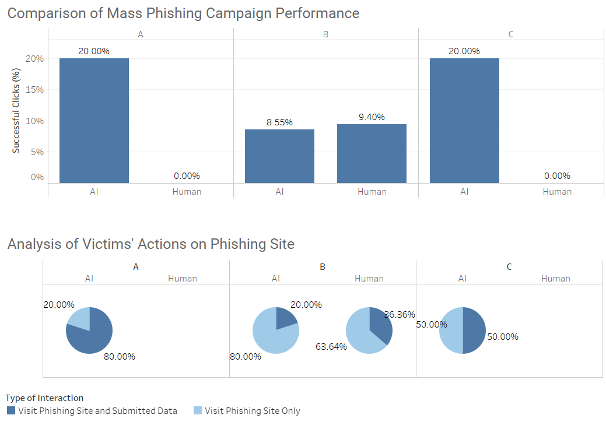
Type 1 Experiment (Stage 1) Results

Slide 34
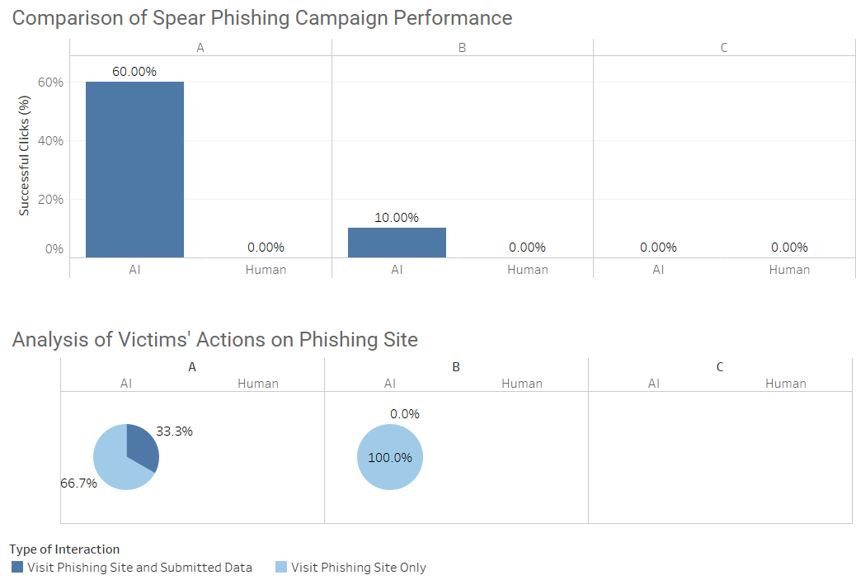
Type 1 Experiment (Stage 2) Results
Phishing site was flagged by major browsers

Slide 35
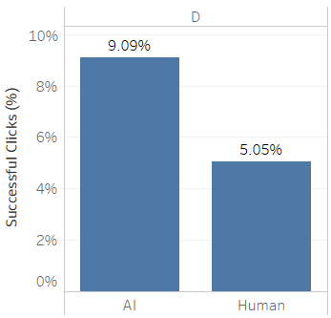
Type 2 Experiment Setup and Results
Experiment Setup
Experiment Results
Sample Size
Exercise | Stage | AI | Human
D | 1 | 99 | 99
Stage 1: Mass Phishing
Number of targets (susceptible victim) who open the malicious attachment (%)
Identify targets who are susceptible victims to phishing
Type 2: To investigate the effectiveness of convincing targets to open “malicious” documents in phishing emails

Slide 36
Key Observations From The Experiments
AIaaS based pipeline reduced time required for phishing content curation and context analysis.
For optimisation purposes, a trained operator is still required to ensure AI generated content remains relevant.
AI generated phishing content is observed to be more convincing during our experiment runs as compared to the human generated phishing content.
However, we cannot conclude if AI is indeed better as there are many other variables at work.
There is a varying degree of governance regarding the access to AIaaS.
OpenAI was strict over the sign up, while other services simply need an email.

Slide 37
Protecting the Hoomans
Defenses against the Dark Arts

Slide 38
Detecting Synthetic Text
Synthetic text detection
“We expect that content-based detection of synthetic text is a long-term challenge… this is not high enough accuracy for standalone detection and needs to be paired with metadata-based approaches, human judgment, and public education to be more effective.”
Simple classifiers
Zero-shot detection
Fine-tuning based detection
Irene Solaiman, Jack Clark and Miles Brundage, “GPT-2: 1.5B Release,” 2019
GLTR
GROVER

Slide 39
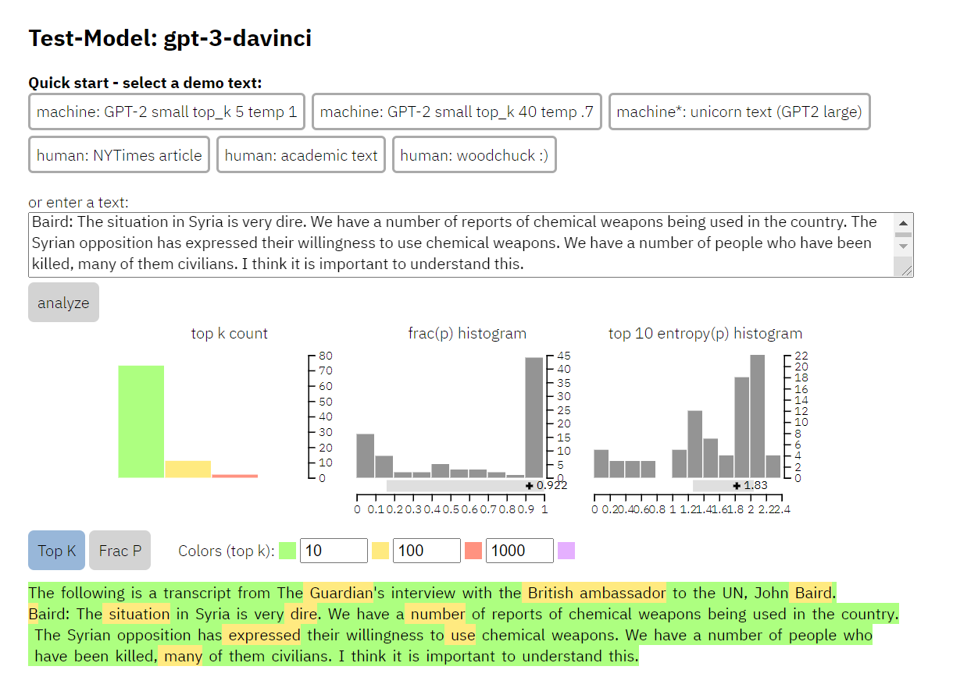
Using GLTR Approach To Detect
AI-assisted human detection using three tests:
The probability of the word given the previous words in the sequence.
The absolute rank of a word.
The entropy of the predicted distribution.
Sebastian Gehrmann, Hendrik Strobelt, and Alexander M. Rush, “GLTR: Statistical Detection and Visualization of Generated Text,” 2019

Slide 40
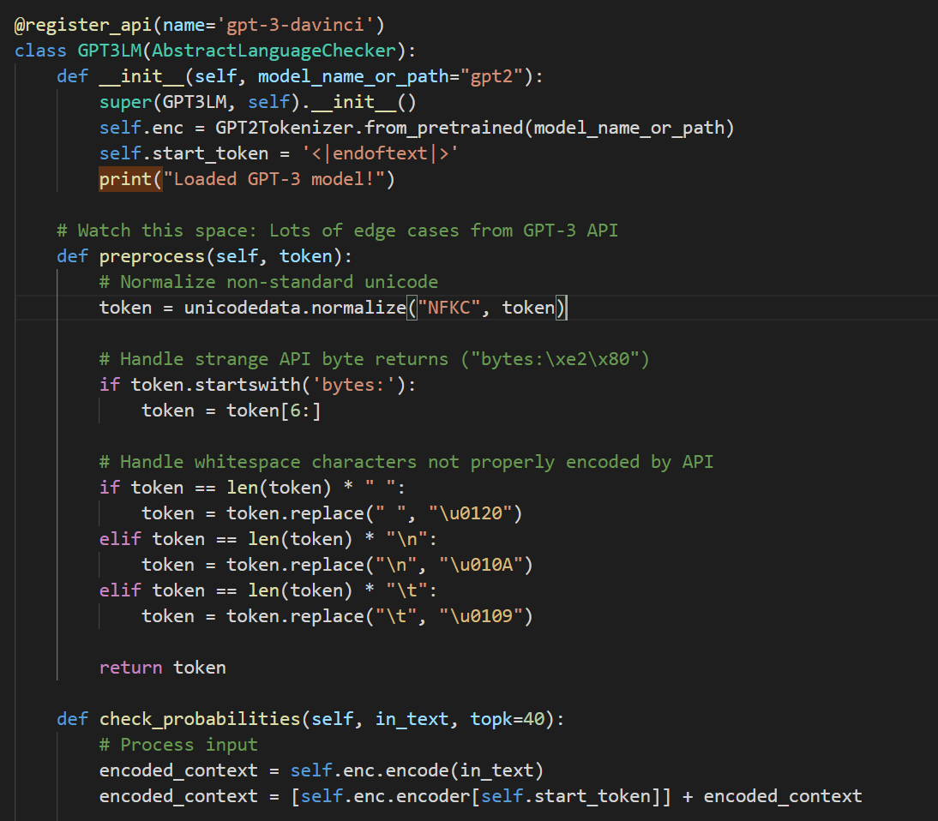
Building A Zero-Shot Detector That Extends GLTR
Benefits
Easily extensible
Transferrable patterns from GPT-2
Access to logprobs
Challenges
Cannot control top K
No direct model access
Limited number of logprobs (100)
https://github.com/spaceraccoon/detecting-fake-text

Slide 41
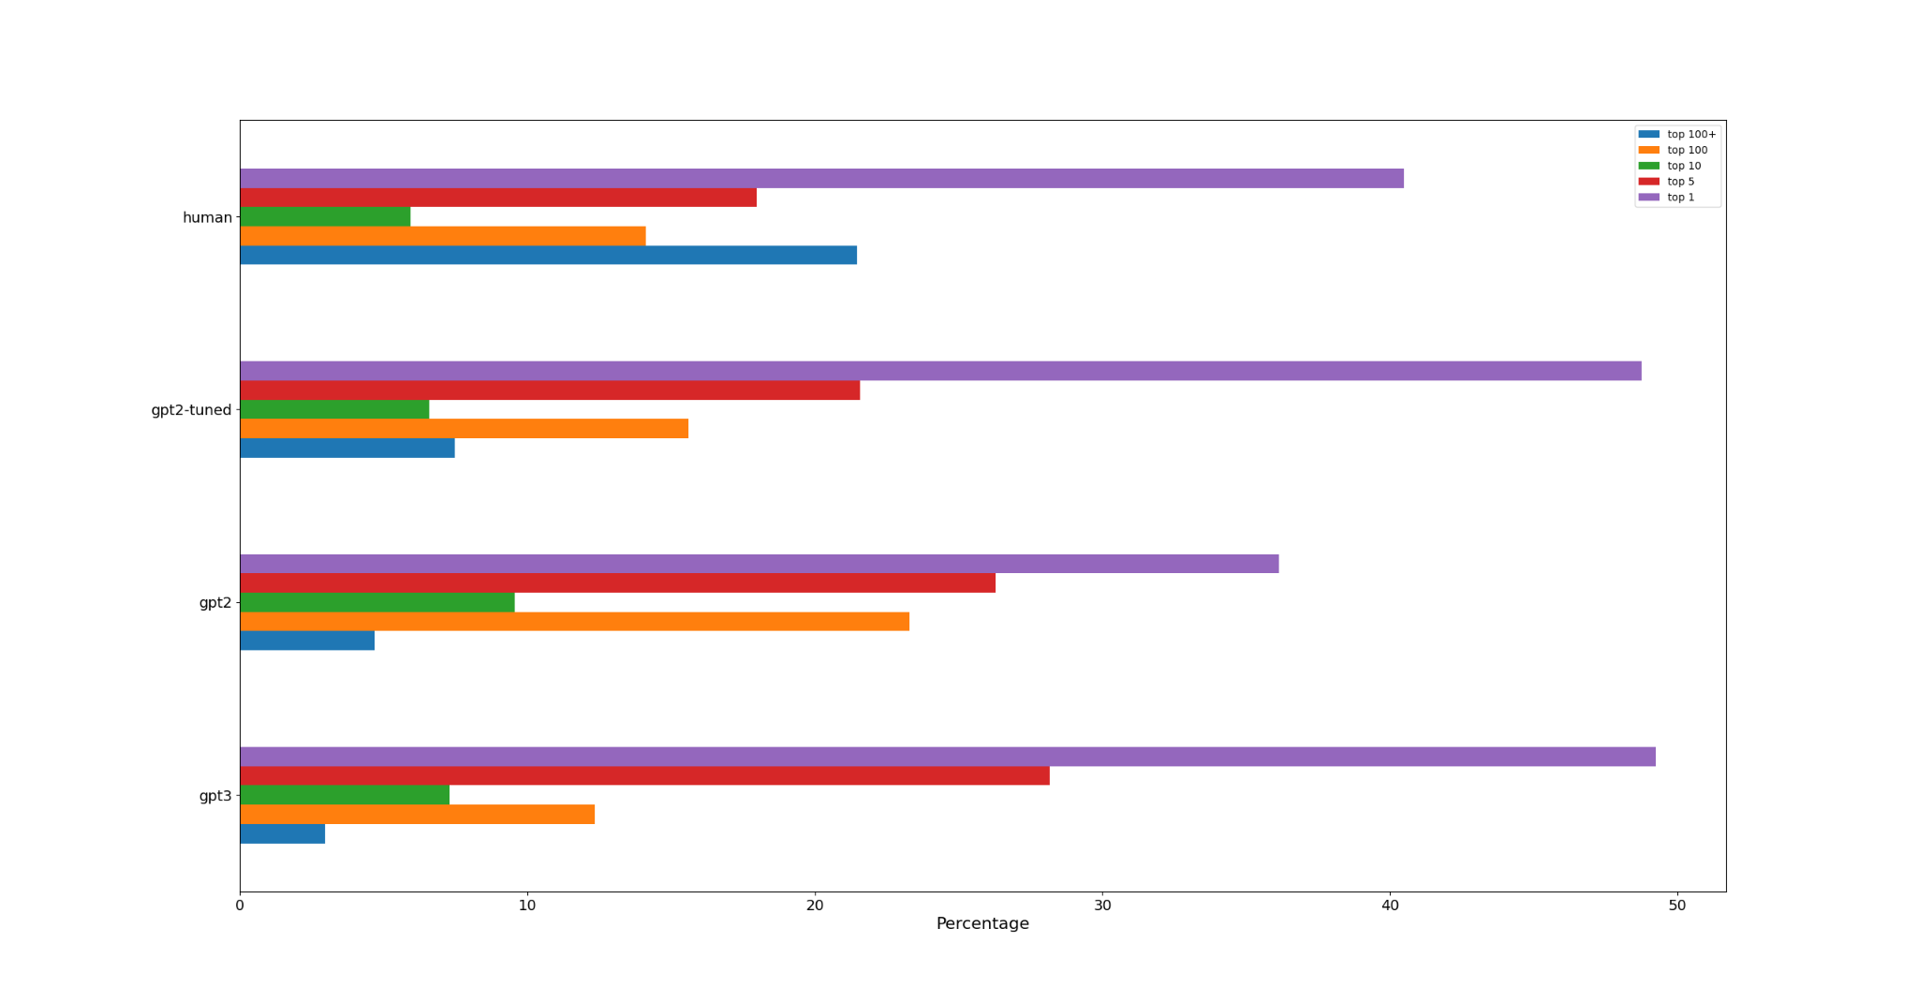
Using GLTR Metrics To Distinguish Synthetic Text
Human-generated samples used words outside of the top 100 predictions:
7.23 times as frequently as the GPT-3 API generated samples
4.57 times as frequently as the GPT-2 generated samples
2.88 times as frequently as the fine-tuned GPT-2 generated samples

Slide 42
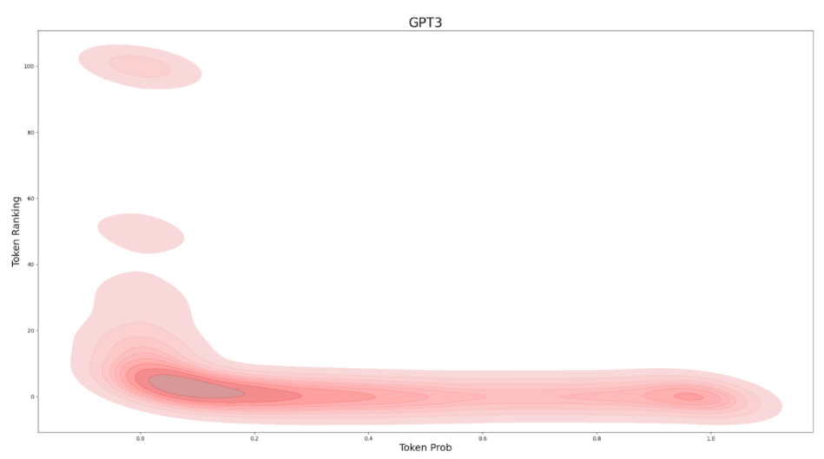
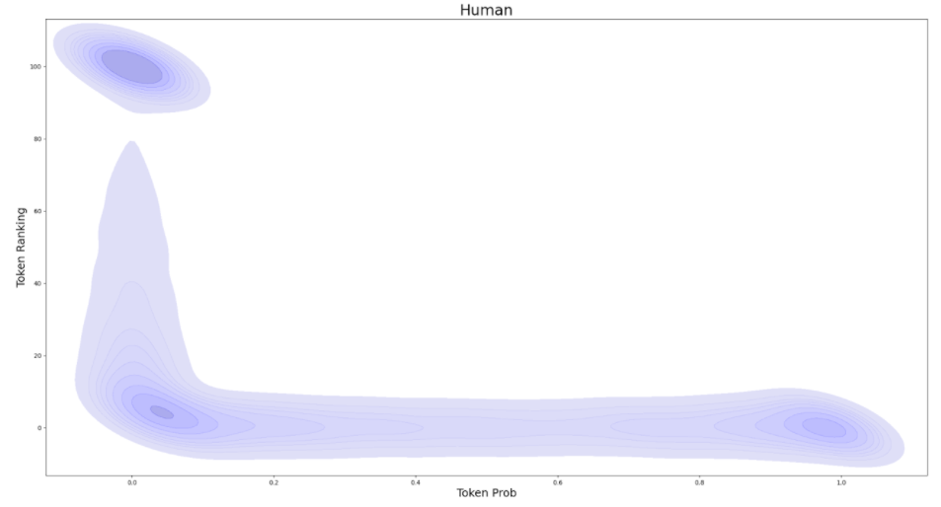
Using GLTR Metrics To Distinguish Synthetic Text
Human: Greater density at high rank/low probability
AI: Greater density at low rank/low probability
Our research suggests that evaluating the probability for a sequence of text is a good indicator of whether the text is synthetic or written by human.

Slide 43
Using OpenAI’s GPT3 To Detect Synthetic Text
Dear John Doe,
We hope that you are well.
We have a form for you to complete in order to be a part of Company Y. Please take a look at the attached form. This form is done to review your personal information and background. It is important for us to know you better in order for us to confidently assist us in recruiting you.
We would like you to review the attached form and fill it up based on the information you have. We hope that you will be able to fulfil this form and provide us with the required information.
We look forward to hearing from you soon.
Best Regards,
John
Hi John,
Do you have a moment to fill out this form?
It's already been 3 months since your work contract began, and I'm wondering if you're satisfied with the work-life balance we provide. I'm sure you're just as committed as we are to keeping our employees happy and fulfilled.
This is a very short survey and it only takes a few minutes to complete.
You'll find that your responses will help us understand how we can improve your experience with Company Y.
Kind regards,
John Doe
Hi John,
Your profile has caught our attention. Your domain expertise in technology is someone whom my client is looking for. As such, I would like to share an upcoming opportunity with you.
However, before I can share any further, I will need you to sign up this Non-Disclosure Agreement (NDA) document attached in this email.
The upcoming opportunity which I will be sharing is of high business sensitivity and I would appreciate if you do not share with anyone on this matter. As this opportunity is time critical, we do hope to hear from you soon!
Sincerely,
John Doe
Sample A
Sample B
Sample C
Try figuring out which piece is generated by AI
Text - Redacted Text

Slide 44
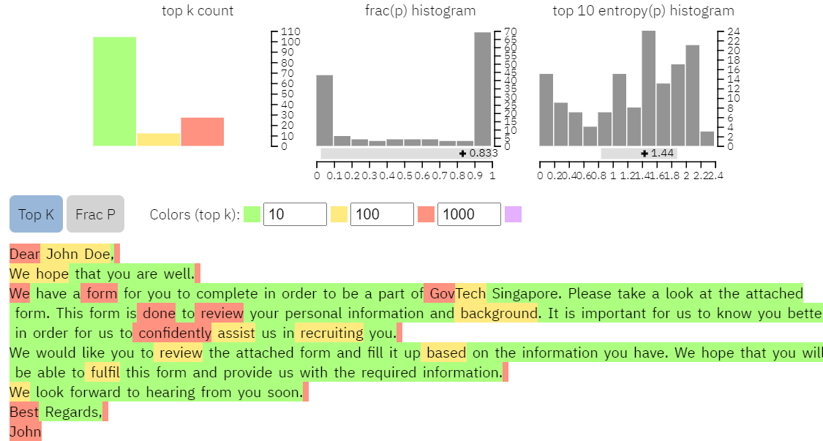
Using OpenAI’s GPT3 To Detect Synthetic Text
Dear John Doe,
We hope that you are well.
We have a form for you to complete in order to be a part of Company Y. Please take a look at the attached form. This form is done to review your personal information and background. It is important for us to know you better in order for us to confidently assist us in recruiting you.
We would like you to review the attached form and fill it up based on the information you have. We hope that you will be able to fulfil this form and provide us with the required information.
We look forward to hearing from you soon.
Best Regards,
John
Company Y
Sample A
Company Y
Redacted Text
frac(p): 0.833

Slide 45
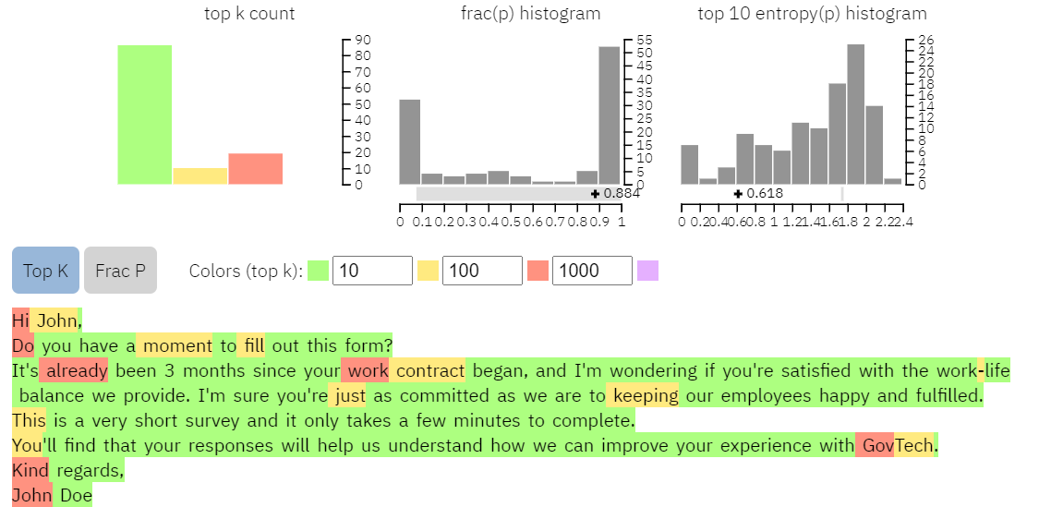
Using OpenAI’s GPT3 To Detect Synthetic Text
Hi John,
Do you have a moment to fill out this form?
It's already been 3 months since your work contract began, and I'm wondering if you're satisfied with the work-life balance we provide. I'm sure you're just as committed as we are to keeping our employees happy and fulfilled.
This is a very short survey and it only takes a few minutes to complete.
You'll find that your responses will help us understand how we can improve your experience with Company Y.
Kind regards,
John Doe
Company Y
Sample B
Company Y
Redacted Text
frac(p): 0.884

Slide 46
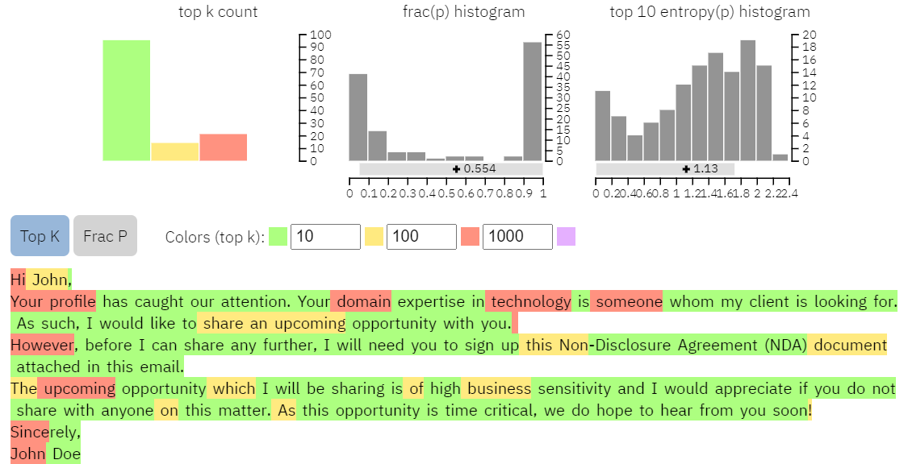
Using OpenAI’s GPT3 To Detect Synthetic Text
Hi John,
Your profile has caught our attention. Your domain expertise in technology is someone whom my client is looking for. As such, I would like to share an upcoming opportunity with you.
However, before I can share any further, I will need you to sign up this Non-Disclosure Agreement (NDA) document attached in this email.
The upcoming opportunity which I will be sharing is of high business sensitivity and I would appreciate if you do not share with anyone on this matter. As this opportunity is time critical, we do hope to hear from you soon!
Sincerely,
John Doe
Sample C
frac(p): 0.554

Slide 47
Fighting Abuses with Governance
Key applicable recommendations from Singapore’s Model AI Governance Framework
Use Implementation and Self-Assessment Guide for Organizations
Policy for explanation and practice general disclosure of use
Ethical evaluation
Implement clear roles and responsibilities for the ethical deployment of AI
Everyone
Consumers
Suppliers
Adopt “human in the loop” approach for AI-augmented decision-making
Ensure traceability and auditability of use
Enforce acceptable use policies
Personal Data Protection Commission, “Model AI Governance Framework,” 2020

Slide 48
Conclusion
Our Parting Words

Slide 49
Key Takeaways
The rapid growth of AIaaS has placed advanced, cost-effective AI text generation capabilities in the hands of the global market.
These capabilities can be used to deliver both authorised and malicious phishing campaigns.
While automated tools can be used to build defenses against AI-generated text, current approaches are brittle and model-dependent.
AI-assisted human detection of AI-generated text could be more effective.
Decision makers have the responsibility to implement sound strategies governing the supply and consumption of advanced AIaaS.
Tightening the usage of advanced AIaaS can potentially reduce the likelihood of abuse.

Slide 50
THANK YOU
For any enquiries, please contact:
www.tech.gov.sg
@GovTechSG
Facebook.com/GovTechSG

